Slide 1

FINAL YEAR PROJECT
ATTENDANCE TRACKING SYSTEM WITH RFID FOR FORM 6
DANISH HOSSMAN BIN ABD RAHMAN
AI210236

Slide 2
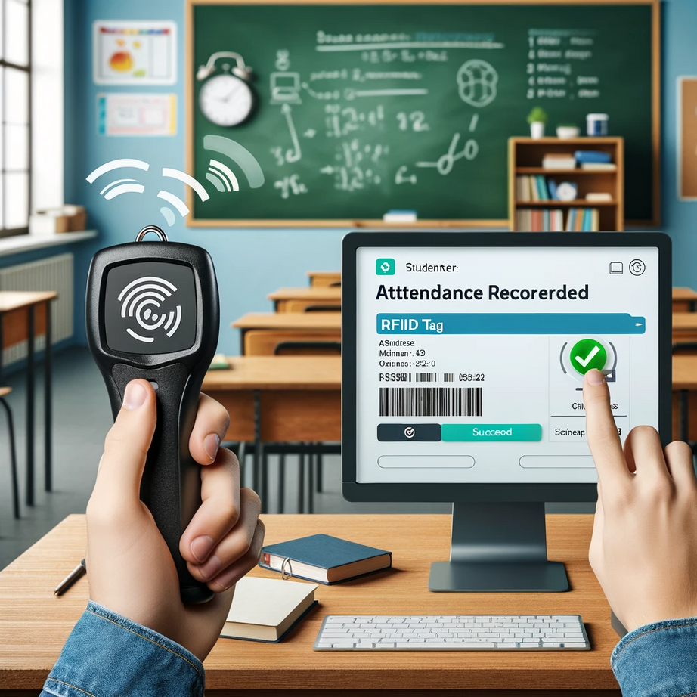

CHAPTER 1
PROJECT BACKGROUND
"RFID Attendance System" project aims to develop a Radio Frequency Identification (RFID)-based system to streamline the process of monitoring student attendance during examinations. This technology is designed to address the inefficiencies and inaccuracies of manual attendance recording methods. By integrating RFID, the system will offer a rapid and reliable means to record attendance, mitigate data loss, and identify latecomers or absentees. The overarching goal is to elevate the standards of academic evaluations, thereby benefiting educational institutions like SMK Benut and setting a benchmark for others to follow.

Slide 3
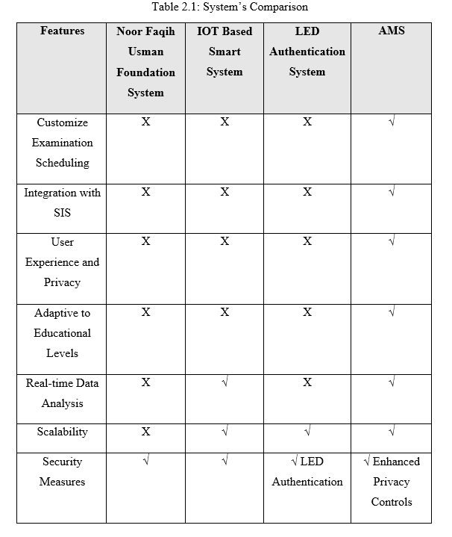
CHAPTER 2
LITERATURE REVIEW

Slide 4
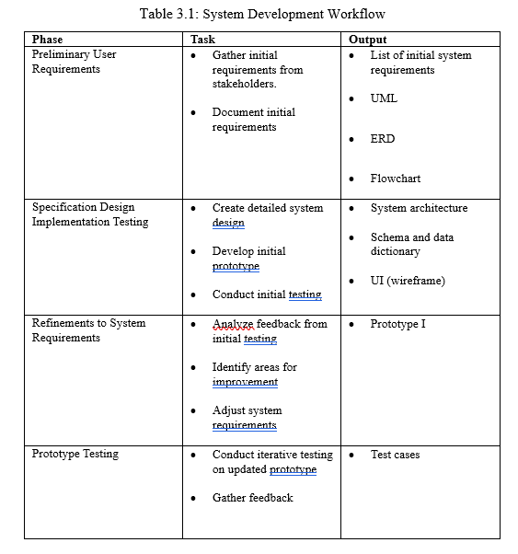
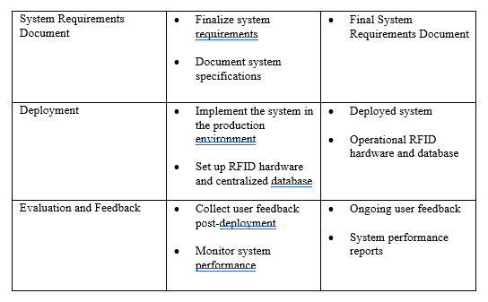
CHAPTER 3
METHODOLOGY

Slide 5
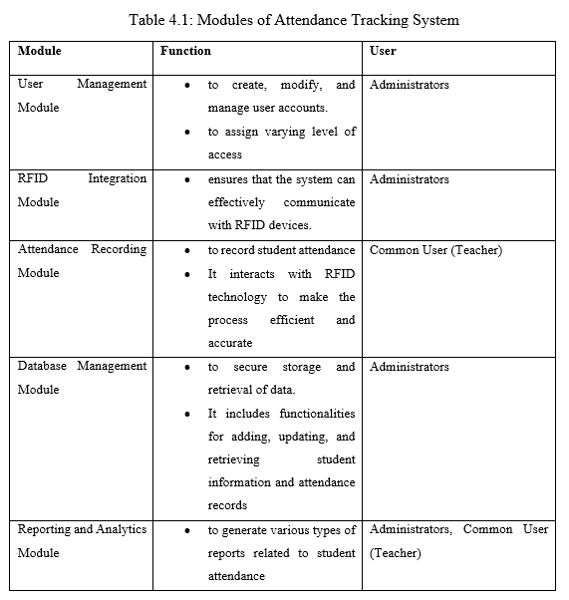
CHAPTER 4
ANALYSIS AND DESIGN
System Requirements

Slide 6
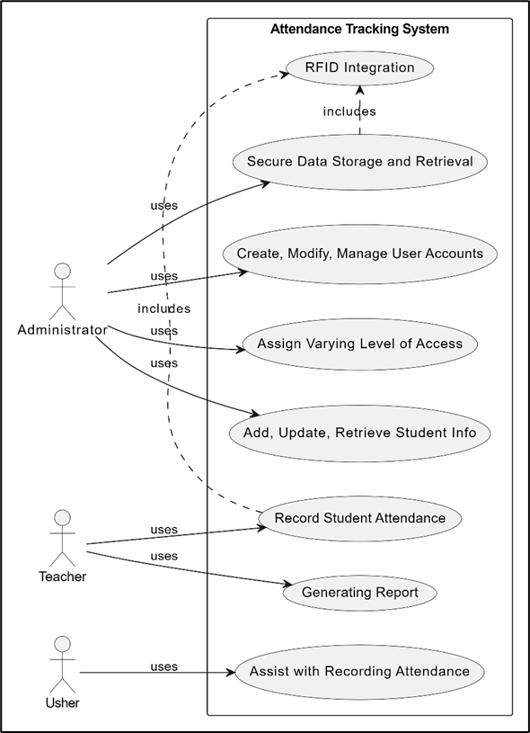
CHAPTER 4
ANALYSIS AND DESIGN
Use Case
A use case diagram is a visual representation in UML that illustrates the functional aspects and interactions of a system from the perspective of its users or external entities. It captures various scenarios, or use cases, depicting how users interact with a system to achieve specific goals.

Slide 7
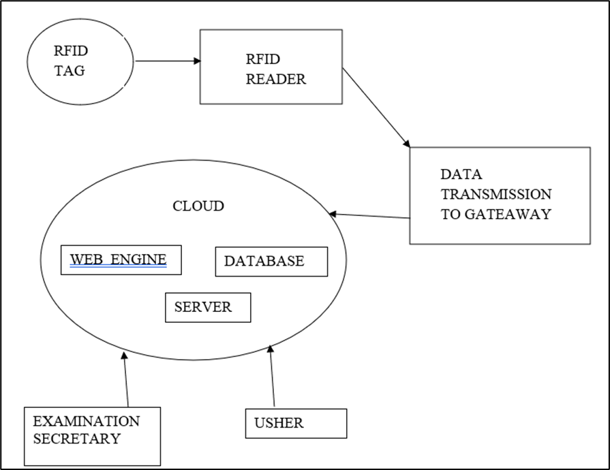
CHAPTER 4
ANALYSIS AND DESIGN
System Architecture

Slide 8
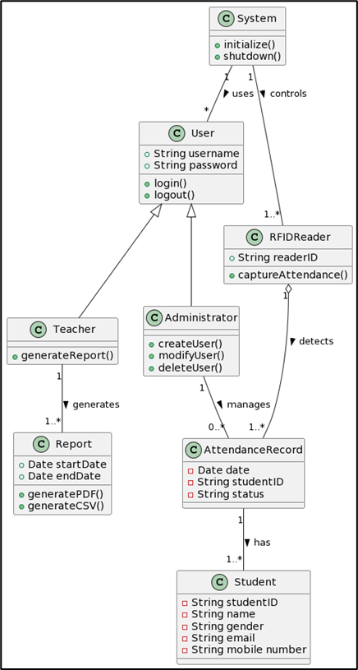
CHAPTER 4
ANALYSIS AND DESIGN
ER Diagram

Slide 9
FINAL YEAR PROJECT
THANK
YOU
DANISH HOSSMAN BIN ABD RAHMAN
AI210236

